Slide 1
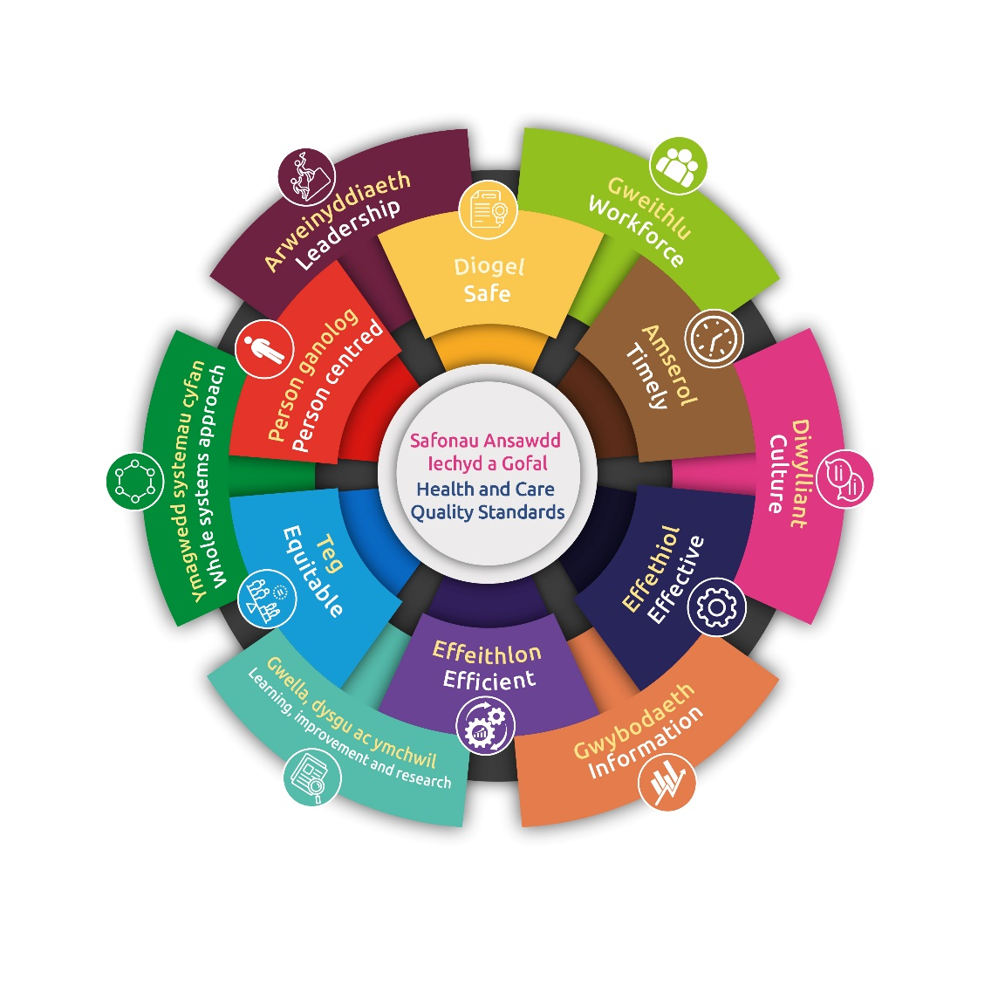
Quality and Safety Assurance Report
Quality, Safety and Experience Committee
October 2023

Slide 2
Situation
The purpose of this report is to provide the Quality, Safety and Experience Committee (QSEC) with an overview of quality and safety across the Health Board.
The Health Board uses a number of assurance processes and quality improvement strategies to ensure high quality care is delivered to patients.
This report provides information on:
Patient safety incidents including a focus on
damage care planning and incident reporting
Nationally reported patient safety incidents
Duty of Candour
Infection control including hand hygiene
The nosocomial COVID-19 review programme
Inspections and peer reviews including activity of Healthcare Inspectorate Wales (HIW)

Slide 3
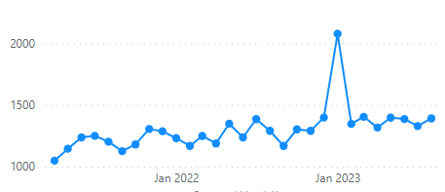
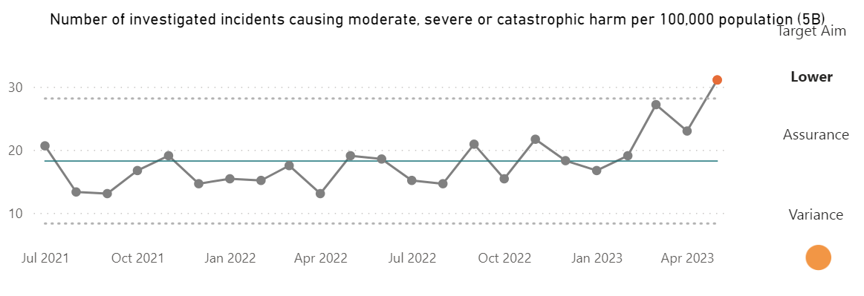
Incident Reporting
Incidents by month reported
There were 16,245 Patient Safety Incidents reported on Datix Cymru in Hywel Dda University Health Board between 1 September 2022 – 31 August 2023.
Of the 16,245 patient safety incidents reported, 9,392 have been closed.
In July and August 2023, 3,080 incidents were reported of which 2,611 were patient safety related
Incident Hot Spots
Work continues to remind investigators that the grade/severity of an incident should reflect whether the investigation identified any acts or inactions by the Health Board that led to a negative outcome for the person affected e.g. an expected death in the community was closed as catastrophic by the service and on review no acts or inactions were identified.
35% deemed avoidable

Slide 4
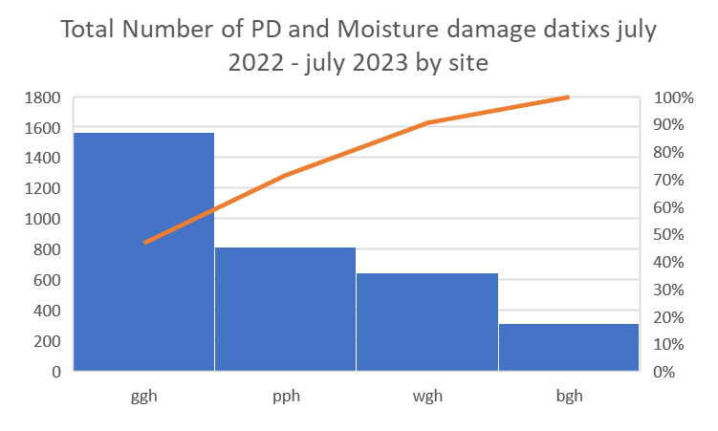
Focus on improving pressure damage care planning and reporting of incidents
Due to the increase in reported incidences of pressure and moisture damage, the Quality Improvement (QI) Team along with Tissue Viability nurses (TVN) have scoped areas throughout the Health Board to identify the core themes/issues to inform improvement activities.
Within the 4 sites there were 3343 reported incidents from the period of July 2022 – July 2023. The themes from these were broken down to ‘admitted with pressure damage’, ‘moisture damage’, ‘acquired pressure’, and ‘pressure damage caused by a device’.
The data has identified that the most common themes are ‘moisture damage present on admission’ and then ‘moisture damage developed following admission’.
Glangwili Hospital (GGH) has the largest recorded number of incidents reported for the categories of pressure and moisture damage. The highest reporting area within the Health Board is GGH Emergency Department (ED)
Identifying issues
Duplication of pressure damage incidents being reported. i.e. an incident report may have been completed in community and a new incident generated on each admission. There is no system in place to identify or correlate duplications.
Documentation of risk assessments and care plans. i.e poor compliance and implementation of both documents.
Digital vs paper. i.e. Risk assessment (digital), care plan (paper), repositioning chart (digital), no digital nursing documentation in ED.
Discrepancies in data. Harms dashboard not consistently updated post scrutiny.
From the data collected further scoping will identify the level of harm for each category, to target improvement activity to reduce the level of harm as well as the number of incident reports.
Current work in place includes :
Tissue Viability workshops on each site which include grading of pressure damage, moisture damage identification and treatment, documentation training from the Professional Practice Development Nurse (PPDN) team , podiatry and dietetic education. TV workshops continue to run on each site.
Plans in place to trial of TVN Champion on identified wards in GGH.
Repose cushions ordered for GGH ED waiting area to promote a proactive approach to the prevention of developing pressure or moisture damage.
QI team supporting with scoping of community, acute site, data and external support and advice to identify new and supportive practices or training in the form of Pressure Ulcer Prevention and Intervention Service (PUPIS) (Swansea Bay) and Welsh Wound Innovation Centre (WICC).

Slide 5
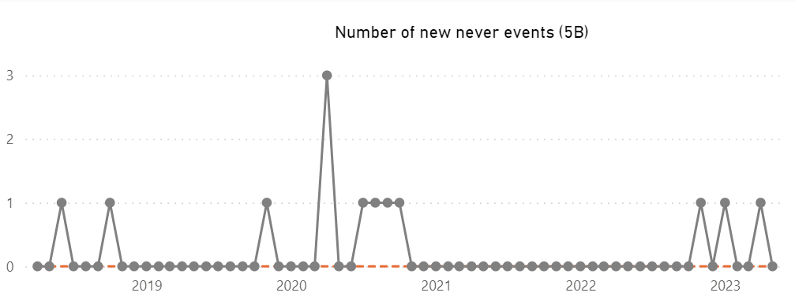
Nationally Reportable Incidents
Timeliness of closure
The Quality Assurance and Safety Team (QAS Team) are undertaking a piece of work to “spot check” review incidents closed on a monthly basis.
The work includes checking that the incident investigation is of sufficient quality, has robust “make safes” and actions to prevent reoccurrence as well as a review of the level of harm allocated at closure.
If any further actions arise from this work the services will be supported to complete the work in a timely manner. The QAS Team are also chasing those nationally reported incidents that are overdue on an ongoing basis.
Learning
The QAS Team are undertaking work on actions and learning identified from incidents with the aim of making the learning robust, through a lens of continual improvement. Action plans are also being uploaded to the Audit Management and Tracking System (AMAT) system going forward.
 | 21/22 Q2 | 21/22 Q3 | 21/22 Q4 | 22/23 Q1 | 22/23 Q2 | 22/23 Q3 | 22/23 Q4 | 23/24 Q1 | Total
Access, Admission | 0 | 0 | 4 | 2 | 2 | 4 | 1 | 0 | 13 (0)
Accident, Injury | 0 | 0 | 0 | 1 | 1 | 1 | 3 | 2 | 8 (3)
Assessment, Investigation, Diagnosis | 0 | 1 | 1 | 3 | 0 | 1 | 0 | 0 | 6 (3)
Behaviour (including violence and aggression) | 1 | 2 | 1 | 1 | 0 | 1 | 0 | 0 | 6 (1)
Infection Prevention and Control | 1 | 0 | 0 | 0 | 0 | 0 | 13 | 7 | 21 (10)
Maternity adverse occurrence | 1 | 0 | 0 | 1 | 1 | 1 | 0 | 1 | 5 (4)
Medication, IV Fluids | 0 | 0 | 1 | 0 | 1 | 0 | 0 | 0 | 2 (0)
Monitoring, Observations | 0 | 0 | 0 | 1 | 0 | 0 | 1 | 0 | 2 (0)
Patient/service user death | 0 | 2 | 6 | 8 | 1 | 8 | 4 | 5 | 34 (17)
Pressure Damage, Moisture Damage | 0 | 0 | 4 | 4 | 1 | 2 | 2 | 4 | 17 (1)
Transfer, Discharge | 0 | 1 | 0 | 0 | 2 | 0 | 0 | 0 | 3 (0)
Treatment, Procedure | 1 | 0 | 1 | 1 | 2 | 2 | 2 | 0 | 9 (4)
Total (total awaiting closure) | 4 (0) | 6 (0) | 18 (2) | 22 (9) | 11 (3) | 20 (6) | 26 (11) | 19 (12) | 126 (43)

Slide 6
Duty of Candour
From the daily review of the Datix records in relation to incidents with a more than minimal report of harm, further work across the Health Board is needed relating to accuracy of reporting actual harm.
A Duty of Candour Scrutiny Panel has been scheduled as a resource for services as a forum staff who can bring and discuss cases that may trigger the Duty or to discuss particularly complex cases.
Having undertaken a random review of some records where the service consider that Duty of Candour has triggered, it is clear that further training is required regarding the conditions to be met for the Duty to trigger:
The first condition is that a person (the “service user”) to whom health care is being or has been provided by the body has suffered an adverse outcome.
The second condition is that the provision of the health care was or may have been a factor in the service user suffering that outcome.

Slide 7
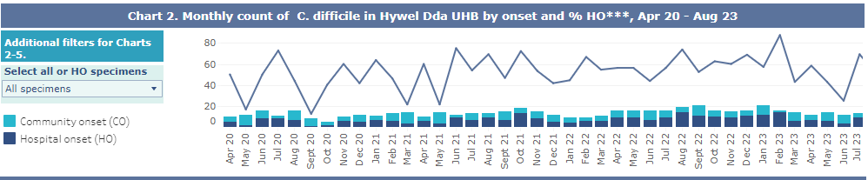
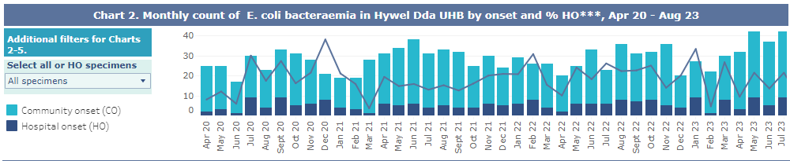
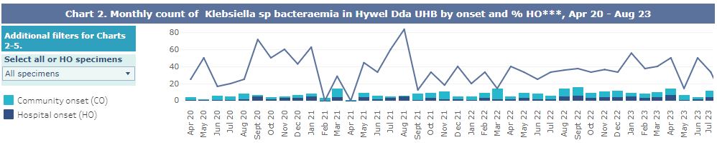
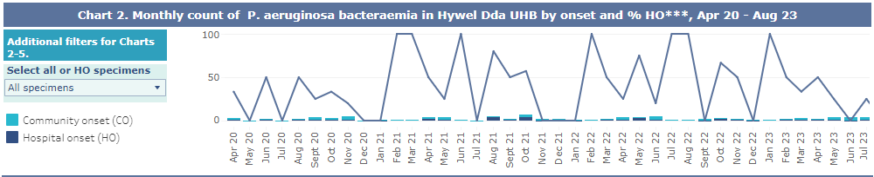
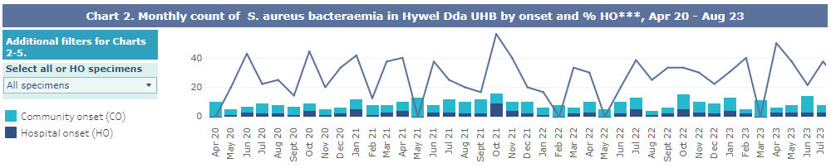
Health Board overview: Infection Prevention and Control (IP&C)
Slight increase in C.diff noted for August with similar picture across many of the other Health Boards, however we remain within the 20% reduction expectation.
A period of increased incidence noted in three areas. Multi disciplinary scrutiny meetings have been held, with the outcome being prescribing of antibiotics outside of guidelines, lack of proton pump inhibitor (PPI) awareness, reduced environmental cleaning and poor hand hygiene considered to be confounding factors. Training and education sessions are place.
Slight improvement in E.coli rates seen during August with only 9% hospital onset. Increased community onset potentially connected to summer holiday traffic and increased temperatures. Hydration and prevention awareness messages delivered at public facing events.
Improvements in Klebsiella rates with reduced numbers noted in August 2023. Five out of six cases are identified as community onset with either urinary or hepatic source identified in each case.
Pseudomonas aeruginosa case numbers remain low and no identified cases within HDUHB were identified during the month of August
Case numbers for S. aureus remain relatively low with continuing community burden. Source of infection remains predominantly skin and soft tissue, though one potential line infection that is being followed up with community teams

Slide 8
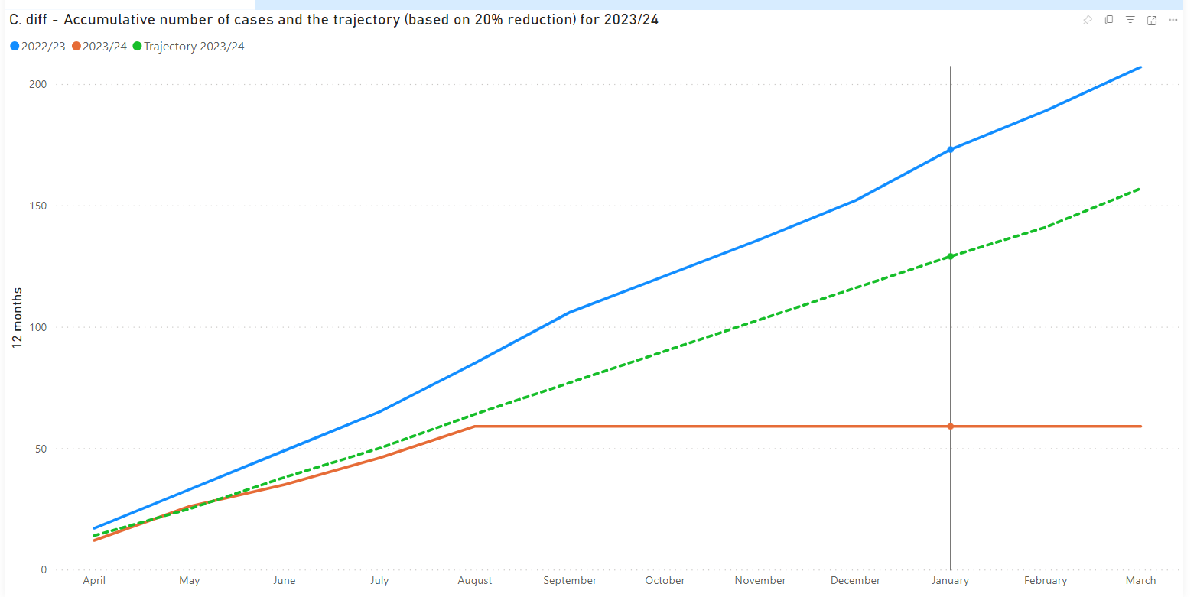
Health Board Overview: IP&C
C.Diff reduction trajectory

Slide 9
Health Board Overview: IP&C
Despite a slight seasonal increase during the month of August 2023, the expectation of a 20% reduction remains.
Aligning actions identified in the Healthcare Associated Infection (HCAI) Improvement Plan with the C.difficile Strategic Plan for Wales, the Health Board continue to strive to reduce cases further:
Anti Microbial Resistance (AMR): Start Smart Then Focus (SSTF) audit completion by the medical teams are slowly making progress. To align with the Strategic Plan further resource is necessary for the Antimicrobial Pharmacists team to collaborate with primary care prescribers.
IP&C: Regular audits of the environment to reactively identify areas in need of repair to enable effective cleaning. Due to age and structure of the estates the use of hydrogen peroxide vapour (HPV) has not been utilised, however the regular use UVC (ultraviolet light) for enhanced decontamination following discharge of C.Di patients takes place.
Lab Testing: The rapid CDI testing on all four acute sites is underway.
Reporting: Identification of CDI patients is communicated to Doctors and Nursing teams electronically and verbally. CDI stickers are inserted into medical notes informing that the patient has a confirmed C.difficile toxin negative or positive result and that Proton Pump Inhibitors (PPI's) and antibiotics should be reviewed.
Treatment and Management: Treatment is followed as per All Wales guidelines and Faecal Microbiota Transplant (FMT) is offered where appropriate, however despite the increasing demand for this effective treatment, the procurement of the faecal matter is causing delays in treatment. The All Wales Strategy suggests that development of a microbiome service is to be developed in Wales over the next 12-24 months. We are also currently completing an application to be involved in a new microbiome trial along with one other Health Board in Wales.
Surveillance and Epidemiology: Working closely with our epidemiologist we scrutinise all CDI cases – both toxin positive and negative to determine whether clusters of the same genomic sequencing are detected. This allows for further targeted scrutiny to be undertaken and action plans developed accordingly.
Workforce: While the shortfall in workforce for cleaning, infection prevention and antimicrobial teams are recognised within the Strategy document, the Health Board continue to focus efforts on areas of need, re-directing staff to fill shortfalls. A nominated C.difficile lead Dr has been identified for each acute site to support in scrutiny meetings and encourage antibiotic stewardship and adherence to SSTF audits.
Investigation: Healthcare acquired CDI cases are reported via the Datix system and outbreaks or periods of increased incidence are reported nationally via the Nationally Reportable Incidents. All cases are investigated internally with a root cause analysis undertaken with a multi-disciplinary approach.
Education Resources: Face to face infection prevention mandatory training is ongoing for all staff groups including Consultants and medical staff. Regular CDI bespoke discussions are held with teams when CDI patient is identified in specific areas. Hotel services staff are fully aware of cleaning processes required and are regularly updated.
Research and Development: While the Strategy discusses further investigations into areas such as wastewater and laundry, the Health Board are keen to expand the FT services – though with some procurement difficulties as identified. As mentioned the Health Board are currently in the process of applying to be part of the Verdanta Microbiome trial.

Slide 10
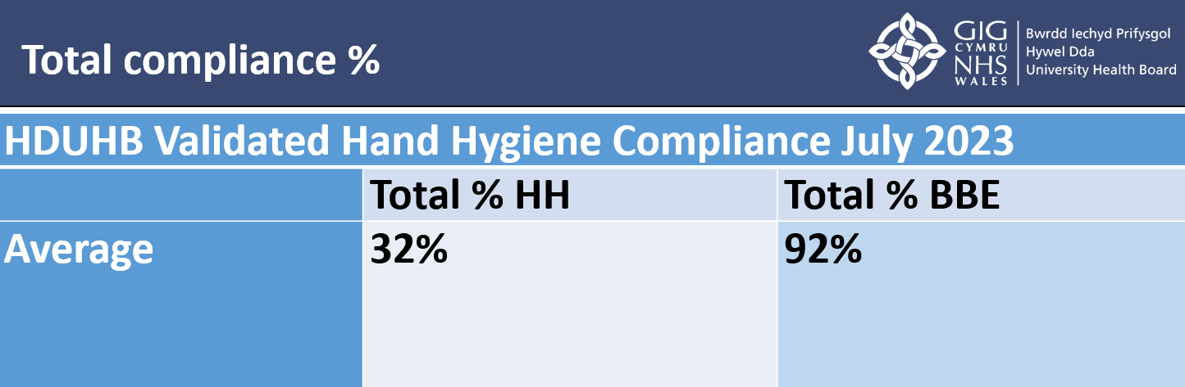
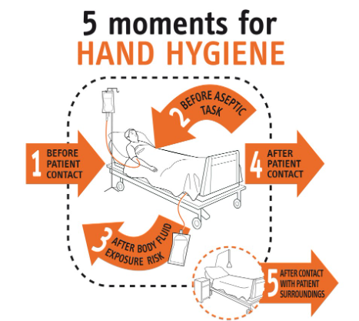
Hand hygiene compliance: Secondary Care
Validated hand hygiene undertaken across all inpatient areas:
Action Plan: to be agreed at Infection Prevention Strategic Steering Group
Introduce system of Peer Audits in place of self-audit with focus on closure of the audit loop.
Initial focus on Moment 1 of the 5 moments for Hand Hygiene: 1 BEFORE PATIENT CONTACT
Communication campaign to raise awareness and influence behaviour:
  Corporate Posters
  Screen Savers – highlighting to Quality & Engagement Act
  Mini Tender for hand hygiene produces and signage across Health Board
  Consider influence of the Patient Charter to engage patients as well as staff in driving improved compliance
  Gloves off campaign

Slide 11
Nosocomial COVID-19 Review Programme
The COVID-19 Programme Review Team and QAS Team continue to make good progress with completion of the reviews where it is suspected that the patient had nosocomial COVID-19 infection during Waves 1 to 4 of the pandemic.
The Corporate Assurance Nosocomial COVID-19 Scrutiny Panel and the Corporate Assurance Nosocomial COVID-19 Strategic Oversight Group continue to meet.
A programme closure report will be prepared and shared with Quality, Safety and Experience Committee (QSEC) at the end of the programme (March 2024).
For learning reported to previous QSEC meetings please see appendices.
Position as at 01/09/2023
 | Wave 1 | Wave 2 | Wave 3 | Wave 4 | Total | Position
 | (27/2/2020 - 26/7/2020) | (27/07/2020 - 16/05/2021) | (17/05/2021 - 19/12/2021) | (20/12/2021 - 30/04/2022) | (01/09/2023) | As at 18/05/2023
Total number of suspected hospital acquired COVID included in the review | 119 | 1043 | 355 | 802 | 2320 | 2320
Total not started / under investigation | 0 | 23 | 21 | 90 | 143 | 327
Total review complete (awaiting decision for panel) | 9 | 2 | 6 | 9 | 17 | 386
Downgraded | 16 | 159 | 78 | 77 | 330 | 195
Total referred to panel (not closed) | 2 | 10 | 3 | 3 | 18 | 91
Total completed investigations | 92 | 849 | 623 | 623 | 1812 | 1321

Slide 12
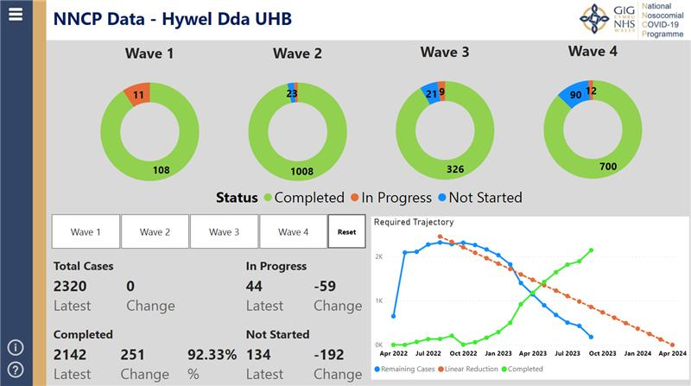
Position, as at the end of August 2023, reported to the National Nosocomial COVID-19 Programme Board

Slide 13
Health Inspectorate Wales (HIW) Quality Checks/Inspections:
Recent reviews and inspections
Area of Review | Recomm-endations | Update
Withybush Hospital (WGH) A&E unannounced inspection | 27 | On 21 August 2023 HIW arrived at WGH A&E for an unannounced inspection. To date only the immediate improvement plan has been received and responded to and feedback is awaited. Nine actions remain open and in progress. None are overdue.
Bronglais Hospital (BGH) Maternity Unit unannounced inspection | 3 | On 1 August 2023 HIW arrived at BGH Maternity Unit for an unannounced inspection. To date only the immediate improvement plan has been received and responded to and assurance has been received in response. Three actions are in progress (one overdue) by the service.
Prince Philip Hospital (PPH) Minor Injury Unit (MIU) unannounced inspection | 23 | On 26 June 2023 HIW arrived at PPH MIU for an unannounced inspection. The improvement plan has been received and responded to and partial assurance has been received in response. A meeting with the inspectorate is being scheduled to clarify the actions the Health Board is taking to tackle the capacity challenges faced by the service. 15 actions remain open including 10 overdue for completion.
National Review of Stroke Pathways | 49 | The Health Board’s contribution to this review, an onsite inspection, took place at BGH between 28 – 30 March and 16 May 2022 for the clinical areas. HIW also interviewed the corresponding staff at PPH, GGH and WGH for Stroke and Patient Flow. The report was published on 7 September and a management group has been arranged to discuss the improvement plan. Further detail on this report is provided later in this report.
Mental Health Discharge Review (Cwm Taf) | 40 | On 7 March 2023, HIW published a report following a review undertaken to assess the quality of discharge arrangements in place within Cwm Taf Morgannwg University Health Board for adult patients being discharged from inpatient mental health services to the community. HIW have now announced a review into discharge from all mental health services for services to benchmark against the learning from the Cwm Taf report. Hywel Dda’s thorough response was submitted on time and 32 actions were allocated, 28 remain open at the point of collating this report (3 overdue).
Child Protection Rapid Review | 0 | Following the publication of a Child Practice Review in November 2022 HIW announced a review into current structures and processes in Wales to ensure children are appropriately placed on, and removed from, the Child Protection Register when sufficient evidence indicates it is safe to do so. The embargoed report was shared with the Health Board on 21 June 2023. The Safeguarding Team are reviewing the report for learning.

Slide 14
HIW Quality Checks/Inspections:
Recent reviews and inspections (cont)
Area of Review | Recomm-endations | Update
Tregaron GP Practice Inspection | 0 | An inspection took place on 16 February 2023. No immediate assurances, concerns nor infection control issues were identified. A few points are expected regarding staff induction and location of the practice policies. The draft report is awaited.
Do Not Attempt Cardio Pulmonary Resuscitation (DNACPR) Review | - | HIW announced a formal review of Health Board’s management of DNACPR patient processes. Submission of a significant number of historical records took place for this review in February 2023. The Health Board were informed on 8 March 2023 that a piece of work is underway for a national thematic review to be carried out by the Mortality Review (MR) Group at the Welsh Delivery Unit. This review has therefore been postponed for the time being.
Argyle Medical Group Inspection January 2023 | 2 | An announced Quality Check took place on 5 January 2023 at the Argyle Medical Group GP surgery. Feedback on the quality related to environmental risk assessment and protocols dates.
A&E (GGH) Inspection December 2022 | 27 | An unannounced inspection took place between 5 and 7 December 2022. There were several areas of immediate assurance required including securing the gas storage room, promotion of privacy and dignity within the surge areas at times of high capacity, resuscitation trolley checks, regularity of assessments for waiting patients, sepsis screening and the safety and wellbeing of children waiting within the department. Following further assurance, the improvement plan for this report was approved and the report published. Of the 8 actions open, 2 have future dates, 6 are overdue

Slide 15
HIW Quality Checks/Inspections:
An update on those previously reported
47% moisture damage; 88% unavoidable pressure damage
Area of Review | Recomm-endations | Update
Maternity (GGH) November 2022 | 12 | An unannounced inspection took place on 29 and 30 November 2022. There were several areas of positive feedback, no immediate concerns highlighted and the recommendations relate to mandatory training and appraisal compliance. The final report was published on 16 February 2023. All actions are now complete.
Ionising Radiation (Medical Exposure) Regulations (IRMER) Inspection (GGH) November 2022 | 19 | An announced inspection took place on 15 and 16 November 2022. The verbal feedback highlighted no immediate concerns and the recommendations relate to the standard of appointment letters, compliance with IRMER regulations, although acknowledgment that work is well underway to address this aspect, processes require updating and staff training. The report was published 24 January 2023. There are currently 5 actions open on AMAT, 3 are overdue.
Angharad ward, (BGH) Paediatric ward October 2022 | 8 | An unannounced inspection took place on 4 and 5 October 2022. The draft report highlighted no immediate concerns, the recommendations relate to timely Child and Adolescent Mental Health (CAMHS) assessments, cleaning chemical storage, the requirement of a new clinical medication fridge, the development of menus, the replacement of flooring and reminders to staff regarding allergies and weight recording on drug charts and the countersignature and printing of names on documentation. The report was published on 5 January 2023. All recommendations are complete.
Bryngofal ward, PPH July 2022 | 19 | An unannounced inspection took place on 11 July 2022. The verbal feedback highlighted no immediate concerns and the recommendations relate to maintenance and refreshing environment, reorganisation of clinical room and the use of an office for staff, the provision of a fridge for patient use, consideration of staff uniforms on escort duty, training records, medication records and highlighting attention to the Consultant Psychiatrist and the Psychologist posts currently vacant. At the point of updating this report there are currently 2 actions open on AMAT that are overdue, one relates to medical cover onsite at PPH and the second relates to replacement of curtains.
Ward 7 PPH February 2022 | 19 | The inspection took place in November 2021 where 19 recommendations were raised on matters such as workforce, medicines management, governance and leadership, infection prevention and risk and health and safety. All recommendations are complete.
National Review of Mental Health Crisis Prevention | 19 | This final report into the national review was published in March 2022 involved services benchmarking themselves against the recommendations suggested. The improvement plan was submitted 27th May 2022 which requires some redesign of pathways of care and development of services, communication and engagement with primary care services and development of some staff roles and recruitment into new staffing models. At the point of updating this report there are at present 3 actions open on AMAT all overdue.

Slide 16
HIW Quality Checks/Inspections:
An update on those previously reported (cont)
47% moisture damage; 88% unavoidable pressure damage
Area of Review | Recomm-endations | Update
Ystwyth Medical group Quality Check | 0 | The quality check took place on 7 February 2022. The review covered environment, infection, prevention and control and governance and staffing. The report made no recommendations of the service.
Llandovery Hospital Quality Check | 0 | The quality check took place on 15 March 2022, following postponement from 2021. The review covered environment, infection, prevention and control, governance and staffing, and some aspects of Covid-19 management. The report made no recommendations of the service.
Tregaron Community Hospital | 29 | An on-site inspection was undertaken on 7th and 8th September 2021, whereby 29 recommendations raised on matters including patient experience, delivery of safe and effective care and quality of management and leadership. At the point of collating this report all recommendations are complete.
HIW IR(ME)R July 2021 WGH | 40 | The improvement plan included access to services, listening to feedback, staff training and some All Wales actions. At the point of collating this report there is 1 action open on AMAT linked to an All Wales piece of work.
Welsh Ambulance Services NHS Trust Acute improvement plan | 31 | This Welsh Ambulance Service improvement plan dating from September 2021 includes recommendations that affect or impact and require action for Acute / Emergency services and departments. At the point of updating this report there are 4 actions are open on AMAT for each site to progress, all actions are overdue.
Withybush General Hospital, St Caradog Ward | 4 | This improvement plan details recommendations in relation to Fire Safety and Health and Safety. There remains 2 actions open on AMAT at the point of collating this report, both are overdue.

Slide 17
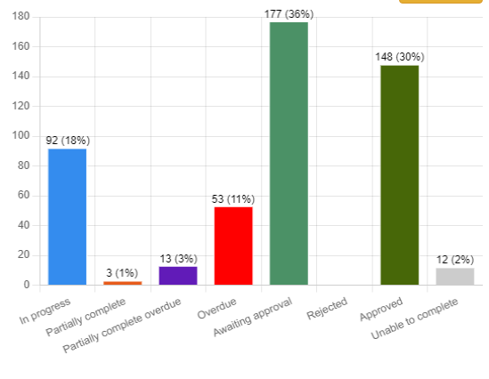
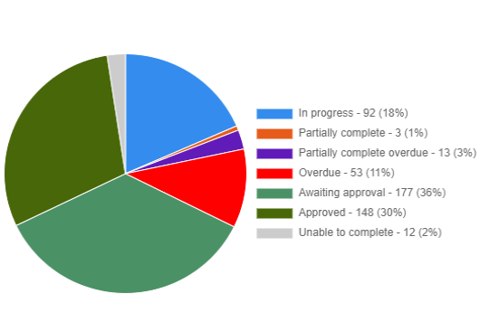
HIW Additional Information, Themes and Trends
Progress of actions agreed following inspections and quality checks
As of 11 September 2023 the current position is a total of 12 reports / inspections with 81 recommendations (actions) open. All these recommendations and actions continue to be chased and tracked by the QAS Team and are uploaded to the AMAT system for services to manage and update direct. Support is provided to services covering AMAT training and assistance to complete actions and the use of AMAT is encouraged. Those recommendations that have exceeded their due date are chased until completion. Data detailing
completion rates (numbers / percentage) from the AMAT
system are shown below :
.
47% moisture damage; 88% unavoidable pressure damage

Slide 18
HIW National Review of Patient Flow (Stroke) Pathways
Site visits took place in March and May 2022 at BGH. Health Board staff (those in the Stroke pathway on all sites) were interviewed and service specific information such as risk assessments and service and patient records were requested to view.
HIW initially shared a draft and on 7 September a full national report which identified 49 far reaching and broad recommendations. It should be noted that the Stroke pathway adopted by Hywel Dda (at BGH) is not reflected in the report. Some examples of the recommendations made are detailed below:
Health Boards should engage with each other, to learn from the good patient education practices taking place across Wales. This could help the shared learning with themselves and with GP practices in their localities, to educate patients of the risks for a stroke, to help reduce the number of strokes across Wales.
Health Boards must communicate with each other to establish the good practices taking in place in some hospitals for the robust management of patient flow. This includes the implementation of effective action plans to manage daily discharges, which remain active throughout the day, and in planning for subsequent days.
Health Boards should consider the benefits of dedicated ‘discharge phlebotomy slots’ for managing the necessary blood tests, to assist with effective and timelier discharge.
Welsh Ambulance Service Trust (WAST) should consider the benefits of training its paramedic staff in the use of the ROSIER stroke assessment tool, to enable staff to differentiate patients with stroke and stroke mimics, such as Transient Ischaemic Attack (TIA).
Welsh Government should consider how it can support WAST to develop and implement improvements with its service delivery model, such as increasing the number of advanced paramedic practitioners across Wales, to help reduce the pressure on EDs and improve flow through healthcare systems.
The QAS Team are facilitating a management group to discuss how to address these recommendations.

Slide 19
Inspection and Peer Review activity
47% moisture damage; 88% unavoidable pressure damage
Other correspondence received from HIW et al
Healthcare Inspectorate Wales’ (HIW) Insight Bulletin
Request for assurance relating to the management of a service user under Mental Health Act section
HIW Mental Health Annual Report 2021 – 2022
Request for records for a deceased service user
Request for historic statements from former staff members
Request for cancer pathway details
Epilepsy in Learning Disabilities services report – the full external review report and management response will be presented to QSEC in December 2023
Thematic review of HIW inspection actions
QAS Team has undertaken a review of all recommendations and actions arising through all Health Board HIW inspections which has been themed. This will be updated and re-presented to QSEC in due course.
Risks and Mitigations
All correspondence received by third parties such as the Welsh Government, the Delivery Unit or Health Inspectorate Wales in relation to their activity is logged on receipt by the QAS Team.
A robust process is in place for co-ordinating and quality checking responses, including gaining executive approval of all HIW submissions, by the required deadlines.
Recommendations arising from HIW, et al, such as immediate assurance plans or final reports are uploaded to the AMAT software. QAS Team also pursue services for updates in advance of any due date.
The QAS Team are supporting services to develop their improvement plans.
The QAS Team are providing updates for reporting to each Audit and Risk Assurance Committee (ARAC) via the Assurance and Risk team.
HIW activity forms part of the quality governance arrangements within Directorates.

Slide 20
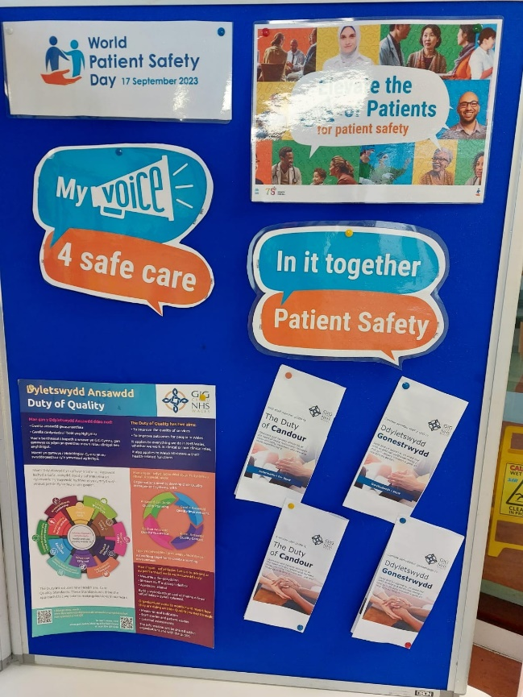
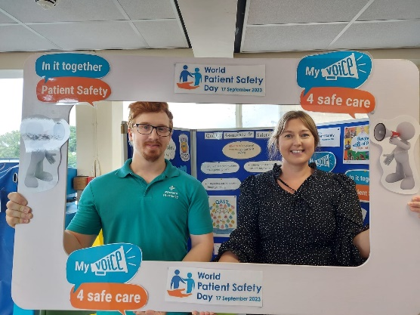
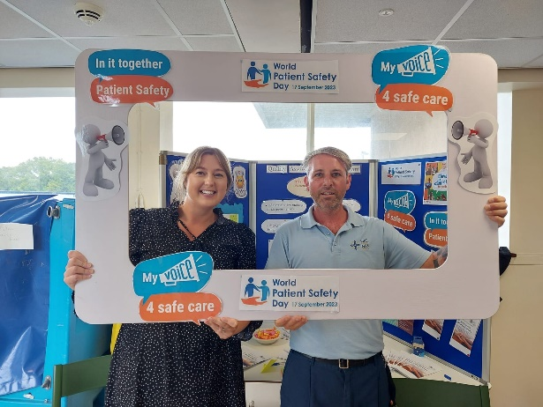
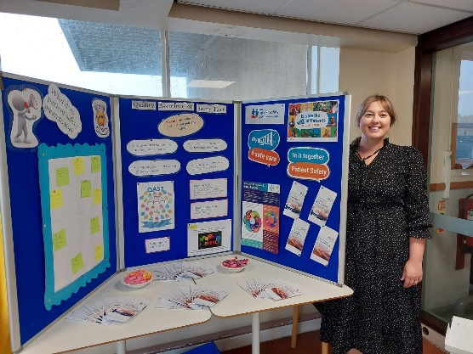
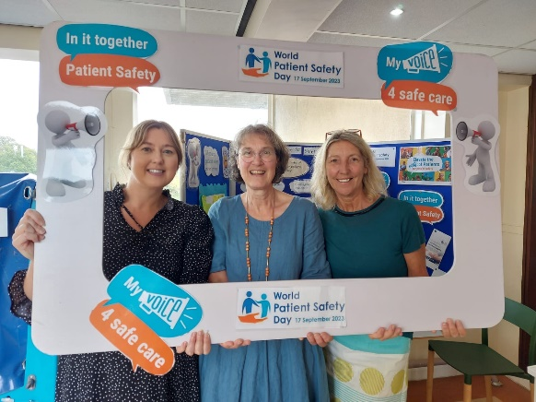
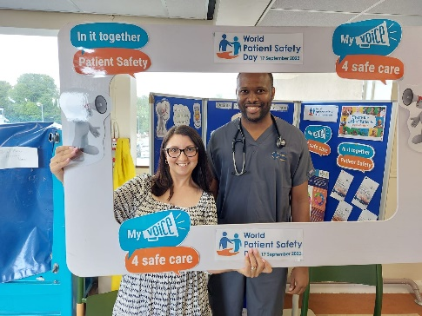
What does patient safety mean to you?
World Patient Safety Day – 17 September
Elevate the voice of the patient
  Preventing my loved one from coming to harm
  A vital part of day to day role to ensure we provide a high service of care.
  Avoiding harm
  Going above and beyond
  Engaging patient’s needs
  Ensuring the patient is well looked after and kept well-nourished at all times
  Providing a safe environment
  Make sure patients are looked after properly
  Engaging staff needs
  Patients have the correct care in hospital
  Doctors and nurses – keeping my family safe
  Patients feel safe whilst having treatment
  Ensure a safe environment around the bedside to prevent tripping hazards
  Communication & speaking out – ensuring eligibility if considering patients are offered participation in any relevant research studies
  They are safe in this hospital.
  They are safe leaving hospital.

Slide 21
Recommendations
The Quality, Safety and Experience Committee is asked to take assurance that processes, including the Listening and Learning Sub Committee, are in place to review, manage and monitor:
Patient safety incidents including a focus on pressure damage care planning and incident reporting
Nationally reported patient safety incidents
Duty of Candour
Infection control including hand hygiene
The nosocomial COVID-19 review programme
Inspections and peer reviews including activity of Healthcare Inspectorate Wales (HIW)

Slide 22
Appendix 1a: COVID Learning identified
(reported August 2023)
The COVID-19 Programme Review Team and QAS Team have seen a number of important local themes coming through these reviews and they should be considered alongside the national learning coming from all Health Boards during this review process. Hywel Dda themes are listed below:
The ageing estate and lack of side rooms for vulnerable patients e.g. those undergoing cancer treatment or shielding patients
The reasons documented in notes for a patient undergoing a swab – this has not always been noted in records, e.g. a contact, the ward suffering a potential outbreak for example
Communications with family once a result from a swab is known. In some cases the communication with family was very good, but not so in all cases
The reasons documented in notes as to why a patient was isolated
Delays in discharge – the review has seen a large number of patient's who were medically fit for discharge (MFFD) but their route to discharge was blocked for a reason such as a) the nursing home destination was closed to admissions due to an outbreak; b) a vulnerable relative at home c) awaiting a package of care and the associated delays getting that in place during the pandemic
Sadly, in a number of cases, some patients who were MFFD remained in hospital, caught COVID-19 and passed away whilst in the hospitals care.

Slide 23
Appendix 1b: COVID-19 Learning identified
(reported January 2023)
Good practice
Timely DNACPR decisions with rationale and discussions documented
Ceilings of care being agreed and documented
Regular medical reviews (well documented)
Use of technology for communication between patient and family
Documentation of bed location and rationale for moving patients
Family members visits being facilitated when end of life
Documentation of Personal Protective Equipment (PPE) usage when patient being visited by relatives
(Note – the above is not consistent across wards and sites)
Areas for Improvement
Medically fit for discharge patients becoming COVID-19 positive whilst waiting for package of care or nursing home placement
Increase the use of technology for communication between patient and family when visiting restricted
Documentation of bed location and rationale for moving patients
Symptomatic patients – reliance on one diagnosis rather than potential differential of COVID-19.

Slide 24
Appendix 1c: COVID Learning identified
(reported to QSEC February 2022)
Areas for improvement
Timely discussions regarding ceilings of care (sometimes more than 5 days after COVID-19 positive test)
Documentation that video call / contact with family has happened
Timely communication from community to hospital e.g. care home closed due to outbreak, ward informed 3 days after care home closed
Good practice
Ceiling of care discussion with patient and family documented
DNACPR discussions with patient and family documented
Initiation of end of life pathway where appropriate
Regular COVID-19 testing following any symptoms
Observations from outbreak reviews
We may be unable to categorically answer how patients became nosocomial COVID-19 positive e.g. staff contact / other patient contact / visitor contact
Early wave 3 outbreaks observation
It would appear that outbreaks are being contained to bays or parts of wards rather than the whole ward being affected

