Slide 1





Welsh Ambulance Services NHS Trust
999 Travel Time Analysis
Final Version
Hywel Dda New Hospital Site Selection – Technical Analysis Information
June 2022
Welsh Ambulance Services NHS Trust

Slide 2
Purpose
Travel time to hospital and ambulance response times were important factors raised during public consultation.
This presentation presents the analysis of the travel time implications for 999 patients requiring conveyance by ambulance to hospital.
Analysis 1: Access to the closest hospital Emergency Department within 1hr
Analysis 2a: Variation in the average travel time to the closest Emergency Department by Lower Super Output Area (LSAO) for each proposed site option compared to the current hospital configuration

Slide 3

WAST Strategic Context
Across Hywel Dda WAST typically convey up to circa 70% of attended 999 incidents to hospital.
WAST’s Long Term Strategic Framework ‘Delivering Excellence’ sets out a clear strategic ambition to safely reduce the number of patients requiring conveyance to hospital (ED). Therefore, a greater proportion of patients will be safely managed, and care episode resolved without requiring an ambulance attendance or a conveyance to hospital.
The Trust is developing transformational plans to ‘Invert the Triangle’ to achieve this ambition.
Key areas that are being considered / developed include:
Hear, Treat & Refer: This is to be achieved through an enhanced virtual clinical triage model including the expansion of our Clinical Support Desk. This will mean more patients receiving self-care advice or referral to other non-ED clinical services to meet ongoing care needs.
See, Treat & Refer: A greater proportion of patients who receive a face to face clinical assessment will have their care episode resolved at home by one of our specialist clinicians (e.g. APPs) or be referred to a primary or community service to meet ongoing care needs in their own home without needing hospital conveyance .
This is a strategic ambition that is being socialised with stakeholders and key partners but is not currently a funded or commissioned service proposal.

Slide 4
Analysis 1: WAST Travel Time Analysis within 1 hour
Objective:
To model historical 999 WAST incidents conveyed to hospital to calculate the % of incidents that can access an Emergency Department within a 1-hour travel time for the proposed new hospital configuration for each of the 3 site locations for the new Urgent & Emergency Care Centre.
Approach:
Source: Optima Ambulance Modelling Software
Mapped historical WAST conveyance data for 2019
A total of 33,808 ‘999’ incidents were conveyed to a hospital within Hywel Dda or Morriston, Swansea in 2019
All incidents were mapped using a 3x3 mile square
Average Road speeds applied
Only includes hospitals with an Emergency Department (excludes Prince Philip hospital)
The three proposed site options were mapped (Whitland SA34 0AD / Narberth SA67 7AR & St Clears SA33 4AG) along with Bronglais & Morriston hospital
Output = calculate the % of historical ambulance incidents that could access an Emergency Department within 1 hour

Slide 5
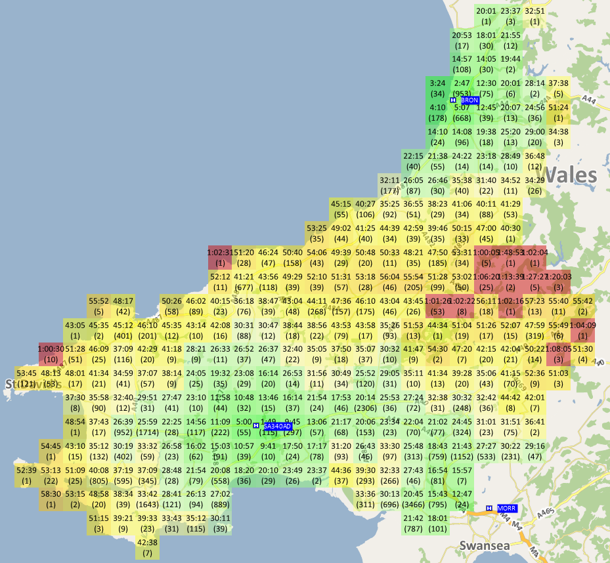
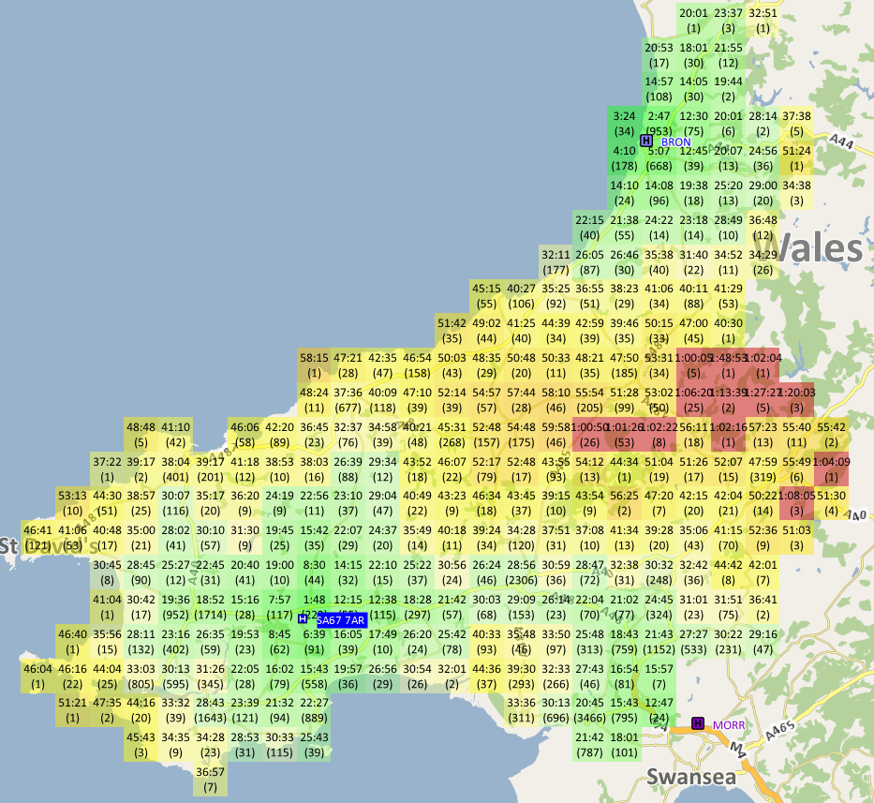
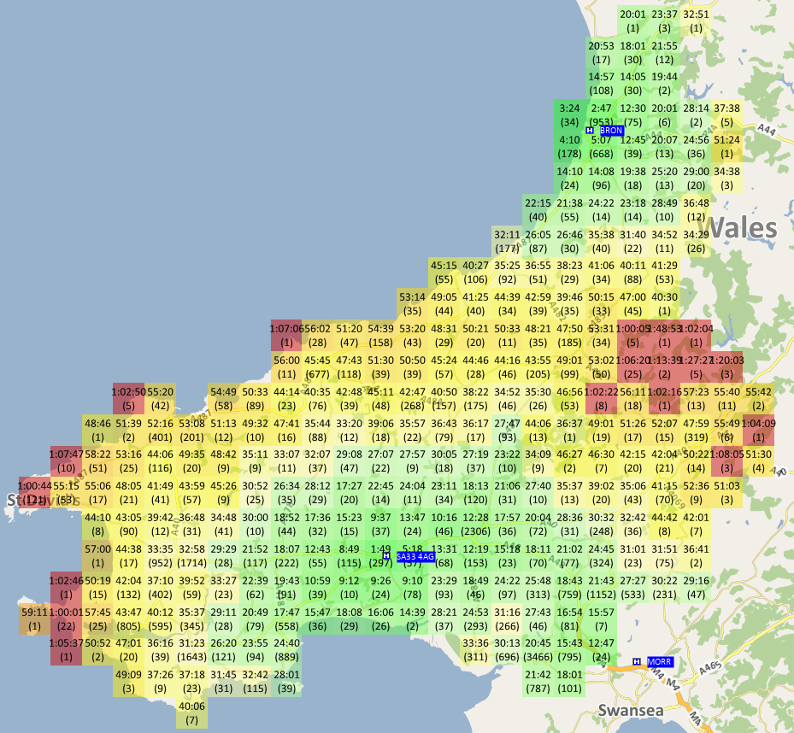
Analysis 1: Findings
Whitland SA34 0AD
Narberth SA67 7AR
St Clears SA33 4AG
98.2% of incidents are within 1hr of either SA34 0AD (Whitland) or Morriston or Bronglais A total of 601 incidents are outside 60mins average travel time.
98.1% of incidents are within 1hr of either SA67 7AR (Narberth) or Morriston or Bronglais
A total of 640 incidents are outside of the 60 mins average travel time.
97.9% of incidents are within 1hr of either SA33 4AG (St Clears) or Morriston or Bronglais
A total of 723 outside 60 mins average travel time.

Slide 6
Analysis 2a: Travel time to the closest Emergency Department by LSOA
Objective:
Map the variation in the population level average travel time for each proposed site option compared with the baseline position (current hospital configuration) by LSOA.
Approach:
Source: Optima Ambulance Modelling Software
Assumption that patients attend their closest hospital with an ED (not symptom specific)
Only includes hospitals with an Emergency Department (excludes Prince Philip hospital)
Actual population data was overlayed to each Lower Super Output Area (LSOA) across Hywel Dda.
LSOAs are geographic boundaries for populations up to 1,500 people
Calculated the average travel time to hospital using Blue Light road speed for each LSOA. Comparing the variation in travel time between the current hospital configuration with an ED (Bronglais, Withybush, Glangwilli & Morriston) and the future hospital configurations for the three proposed site options:
  Whitland (SA34 0AD) plus Bronglais & Morriston
  Narberth (SA67 7AR) plus Bronglais & Morriston
  St Clears (SA33 4AG) plus Bronglais & Morriston

Slide 7
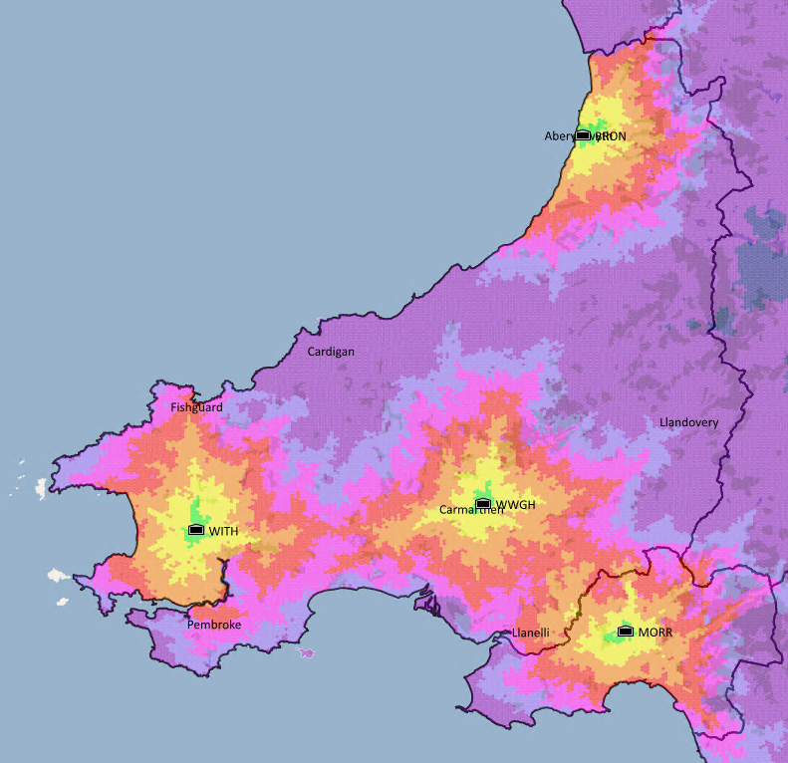
Analysis 2a: Travel time heat maps to the nearest Emergency Department
Baseline Hospital Configuration
Bronglais
Morriston
Glangwili
Withybush
Modelling Parameters
Lights & Sirens speed
Friday 8AM

Slide 8
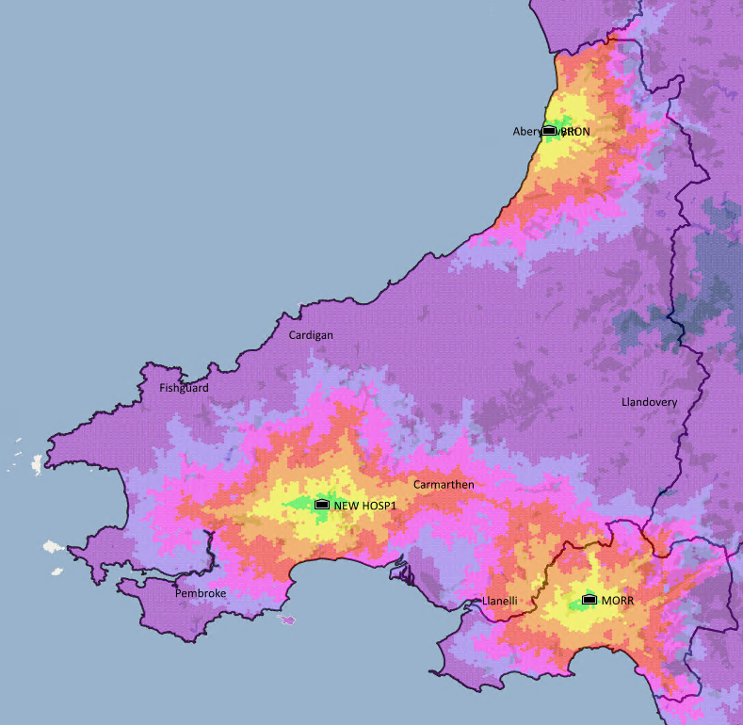
Analysis 2a: Travel time heat maps to the nearest Emergency Department
Whitland Option
Bronglais
Morriston
Whitland
Modelling Parameters
Lights & Sirens speed
Friday 8AM

Slide 9
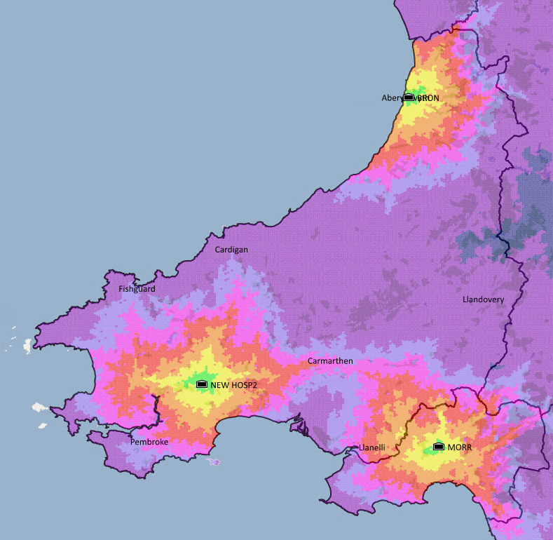
Analysis 2a: Travel time heat maps to the nearest Emergency Department
Hea Map Analysis
Narberth Option
Bronglais
Morriston
Narberth
Modelling Parameters
Lights & Sirens speed
Friday 8AM

Slide 10
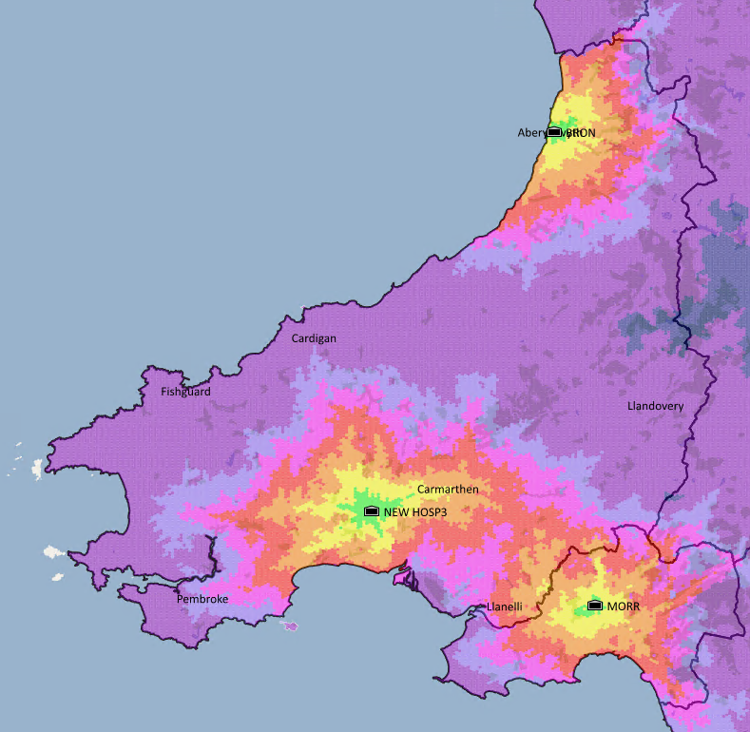
Analysis 2a: Travel time heat maps to the nearest Emergency Department
St Clears Option
Bronglais
Morriston
St Clears
Modelling Parameters
Lights & Sirens speed
Friday 8AM

Slide 11
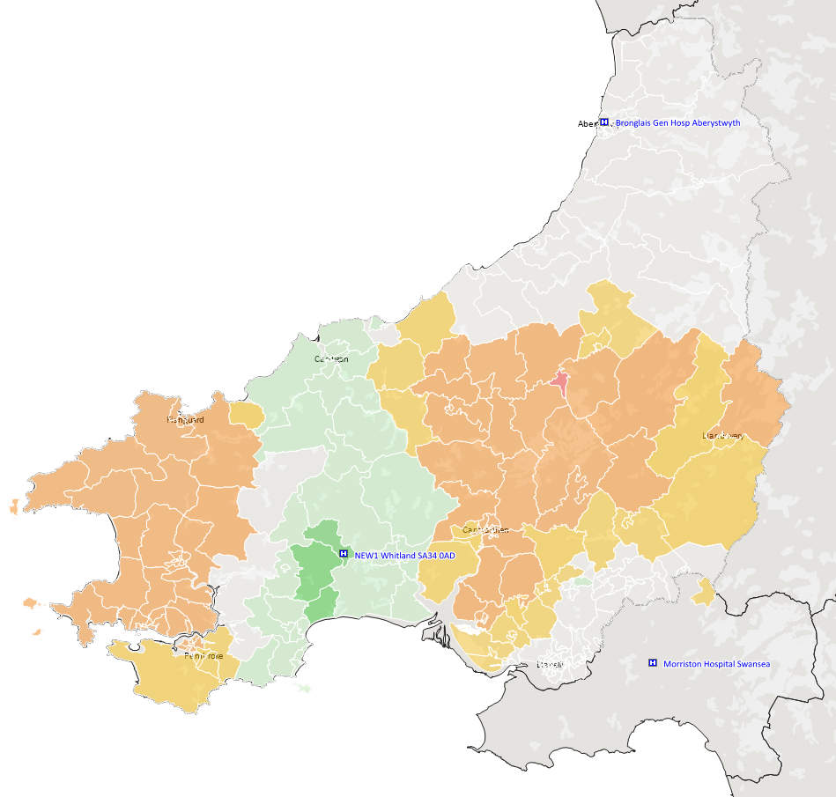
Analysis 2a: Variation in travel time by LSOA to the closest hospital with an Emergency Department
Map outlining the variation in travel time by LSOA & Population base for each proposed site against the baseline (current hospital configuration)
Whitland Option
Bronglais
Morriston
Whitland
Modelling Parameters
Lights & Sirens speed
Friday 8AM
Baseline Hospital Configuration
Bronglais / Morriston / Glangwili / Withybush

Slide 12
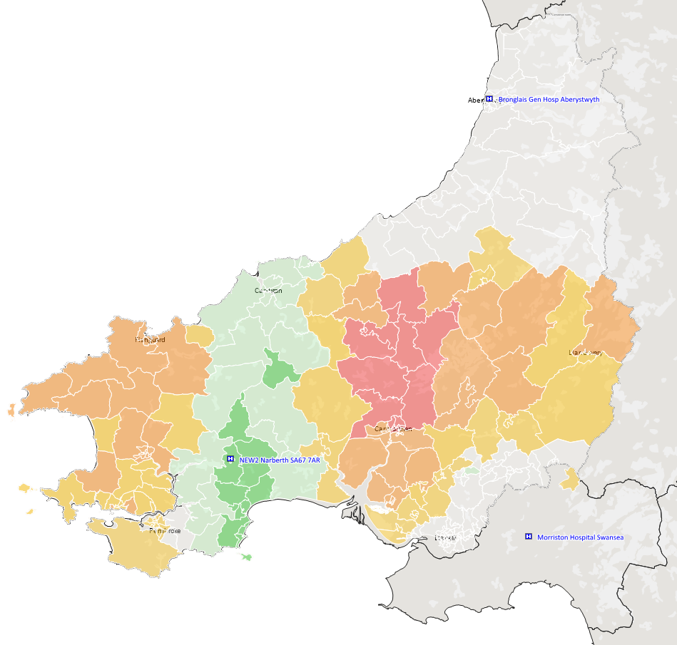
Analysis 2a: Variation in travel time by LSOA to the closest hospital with an Emergency Department
Map outlining the variation in travel time by LSOA & Population base for each proposed site against the baseline (current hospital configuration)
Narberth Option
Bronglais
Morriston
Narberth
Modelling Parameters
Lights & Sirens speed
Friday 8AM
Baseline Hospital Configuration
Bronglais / Morriston / Glangwili / Withybush

Slide 13
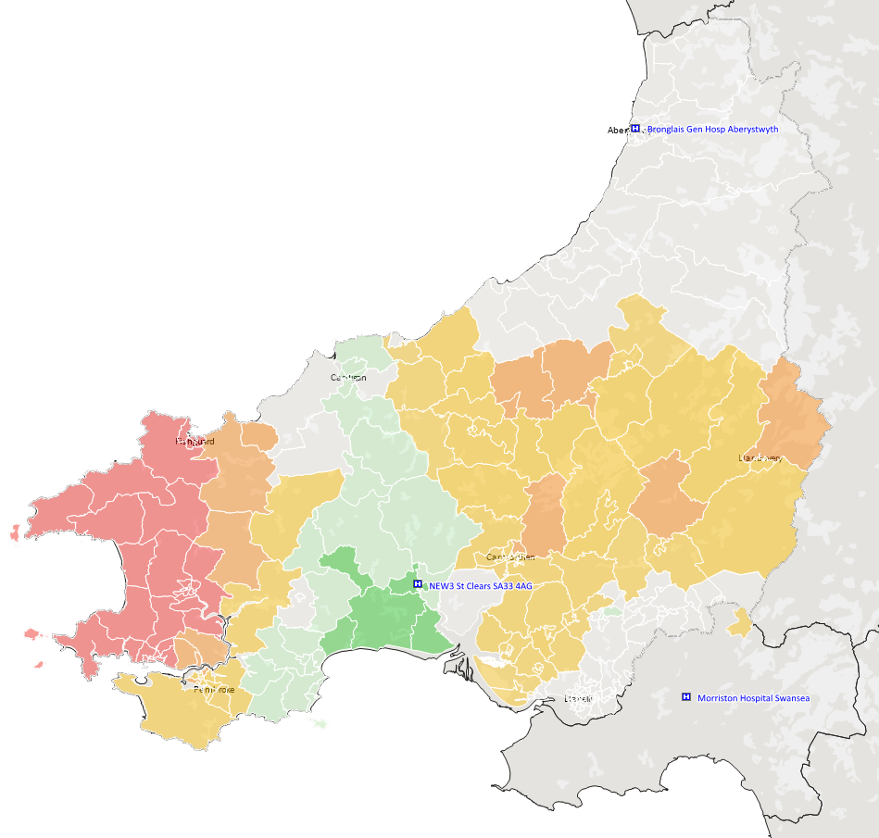
Analysis 2a: Variation in travel time by LSOA to the closest hospital with an Emergency Department
Map outlining the variation in travel time by LSOA & Population base for each proposed site
against the baseline (current hospital configuration)
St Clears Option
Bronglais
Morriston
St Clears
Modelling Parameters
Lights & Sirens speed
Friday 8AM
Baseline Hospital Configuration
Bronglais / Morriston / Glangwili / Withybush

Slide 14
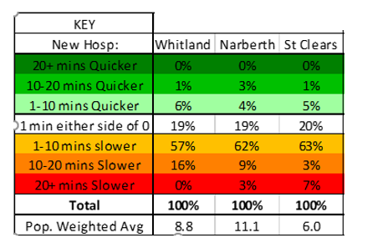
Analysis 2a: Variation in travel time by LSOA to the closest hospital with an Emergency Department
What Percentage of Hywel Dda Population is affected in a positive / negative way of Travel Time ?
Population Weighted Average: shows the average travel time change from Baseline per person for each scenario.
E.g. The average person has a travel time of 8.8 minutes slower than baseline.
This says that 1% of the Hywel Dda population are in an LSOA that have an average travel time to hospital 10-20 mins quicker in than the baseline.
Some patients may experience a longer travel time to hospital. The new model is predicated upon providing the highest quality of care to improve patient outcomes.
To ensure we have in place the right ambulance capacity in the right place to provide a clinically effective and timely response to service users. The impact on ambulance capacity and job cycle times will be modelled in more detail in conjunction with the detailed development of the AHMWW clinical model. Furthermore we are exploring co-locating an MRD and ambulance station on the new site to support response times and reduce vehicle downtime.

Slide 15
Additional Information
Analysis 2b: Population travel time analysis to access the closest hospital including Prince Philip

Slide 16
Analysis 2b: Population travel time analysis to access the closest hospital including Prince Philip
Objective:
Map the variation in the population level travel time for each proposed site option compared with the baseline position (current hospital configuration) by LSOA
Approach:
Source: Optima Ambulance Modelling Software
Assumption that patients attend their closest hospital (not symptom specific). Prince Philip has been included in this scenario noting that some ambulance patients may be conveyed here, but it does not have an Emergency Department in the future model.
Population data was overlayed to each LSOA across Hywel Dda
Calculated the average travel time to hospital using Blue Light road speed for each LSOA
Applied the baseline travel time for the current hospital configuration with an ED – Bronglais, Withybush, Prince Philip, Glangwilli & Morriston
Compared the variation in average travel times against the future hospital configuration with an ED for each of the three proposed site options:
  Whitland (SA34 0AD) plus Bronglais & Morriston
  Narberth (SA67 7AR) plus Bronglais & Morriston
  St Clears (SA33 4AG) plus Bronglais & Morriston

Slide 17
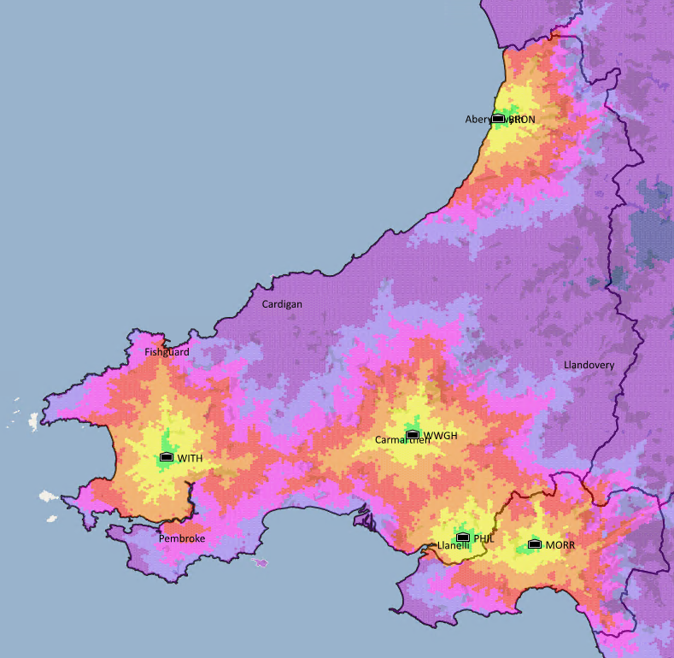
Analysis 2b: Travel time heats maps to the nearest hospital including Prince Philip
Baseline Hospital Configuration
Bronglais
Morriston
Glangwili
Withybush
Prince Philip
Modelling Parameters
Lights & Sirens speed
Friday 8AM

Slide 18
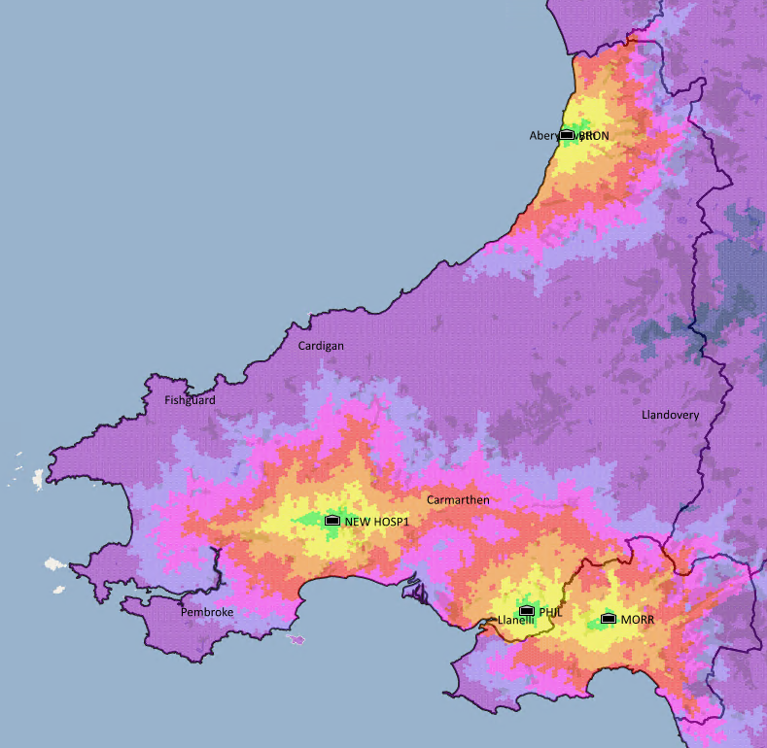
Analysis 2b: Travel time heats maps to the nearest hospital including Prince Philip
Whitland Option
Bronglais
Morriston
Prince Philip
Whitland
Modelling Parameters
Lights & Sirens speed
Friday 8AM

Slide 19
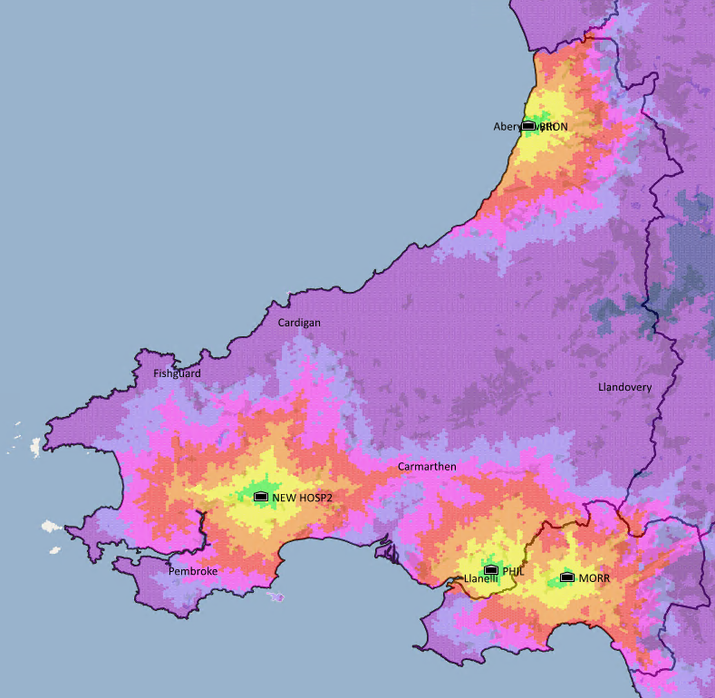
Analysis 2b: Travel time heats maps to the nearest hospital including Prince Philip
Narberth Option
Bronglais
Morriston
Prince Philip
Narberth
Modelling Parameters
Lights & Sirens speed
Friday 8AM

Slide 20
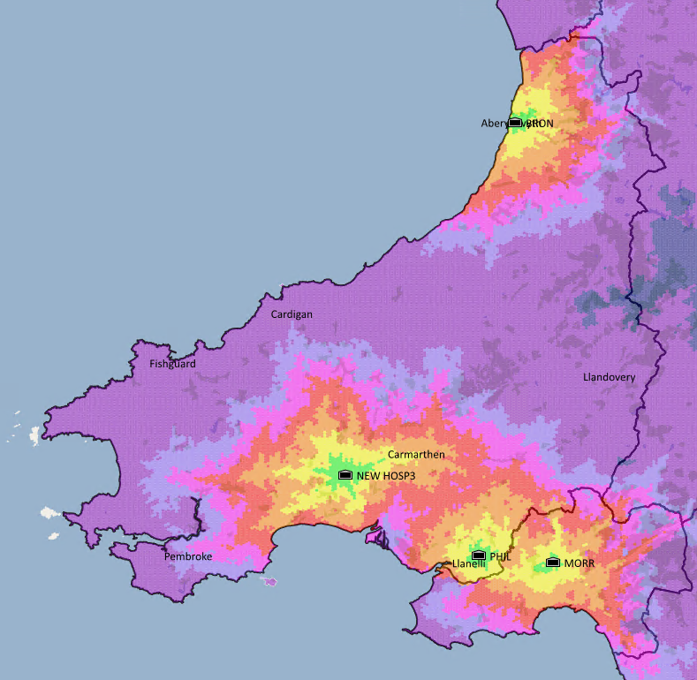
Analysis 2b: Travel time heats maps to the nearest hospital including Prince Philip
St Clears Option
Bronglais
Morriston
Prince Philip
St Clears
Modelling Parameters
Lights & Sirens speed
Friday 8AM

Slide 21
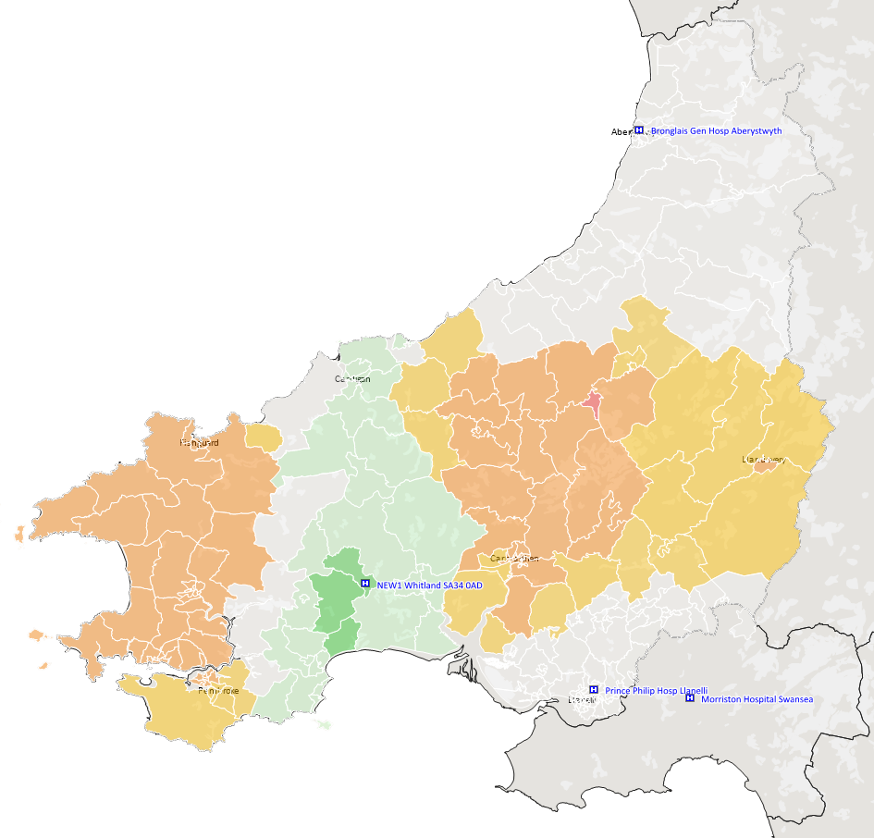
Analysis 2b: Variation in travel time by LSOA to the closest hospital including Prince Philip
Map outlining the variation in travel time by LSOA & Population base for each proposed site against the baseline (current hospital configuration)
Whitland Option
Bronglais
Morriston
Prince Philip
Whitland
Modelling Parameters
Lights & Sirens speed
Friday 8AM
Baseline Hospital Configuration
Bronglais / Morriston / Glangwili / Withybush & Prince Philip

Slide 22
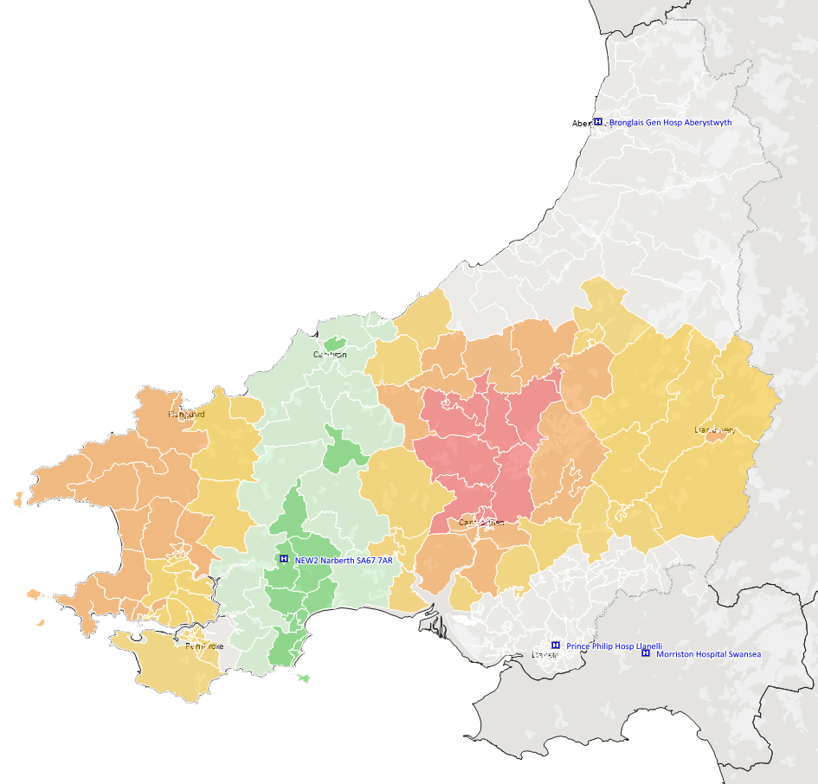
Analysis 2b: Variation in travel time by LSOA to the closest hospital including Prince Philip
Map outlining the variation in travel time by LSOA & Population base for each proposed site against the baseline (current hospital configuration)
Narberth Option
Bronglais
Morriston
Prince Philip
Narberth
Modelling Parameters
Lights & Sirens speed
Friday 8AM
Baseline Hospital Configuration
Bronglais / Morriston / Glangwili / Withybush & Prince Philip

Slide 23
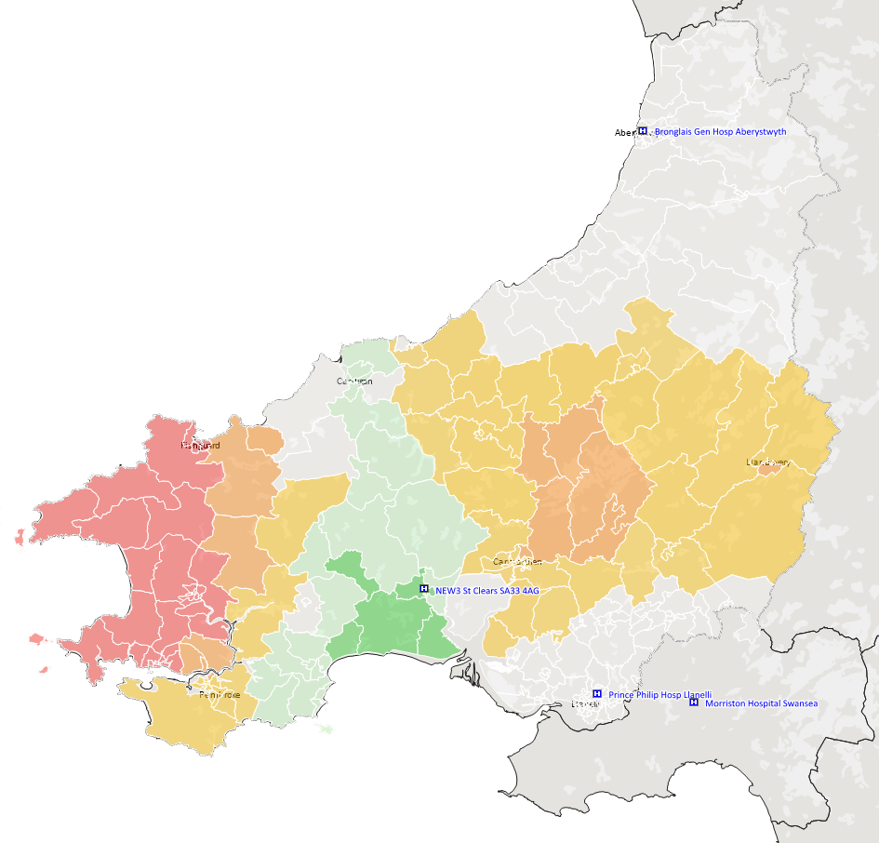
Analysis 2b: Variation in travel time by LSOA to hospital including Prince Philip
Map outlining the variation in travel time by LSOA & Population base for each proposed site against the baseline (current hospital configuration)
St Clears Option
Bronglais
Morriston
Prince Philip
St Clears
Modelling Parameters
Lights & Sirens speed
Friday 8AM
Baseline Hospital Configuration
Bronglais / Morriston / Glangwili / Withybush & Prince Philip

Slide 24
Analysis 2b: Variation in travel time by LSOA to hospital including Prince Philip
What Percentage of Hywel Dda Population is affected in a positive / negative way of Travel Time ?
Population Weighted Average: shows the average travel time change from Baseline per person for each scenario.
E.g. The average person has a travel time of 4.5 minutes slower than baseline.
This says that 1% of the Hywel Dda population are in an LSOA that have an average travel time to hospital 10-20 mins quicker in than the baseline.

